Slide 1
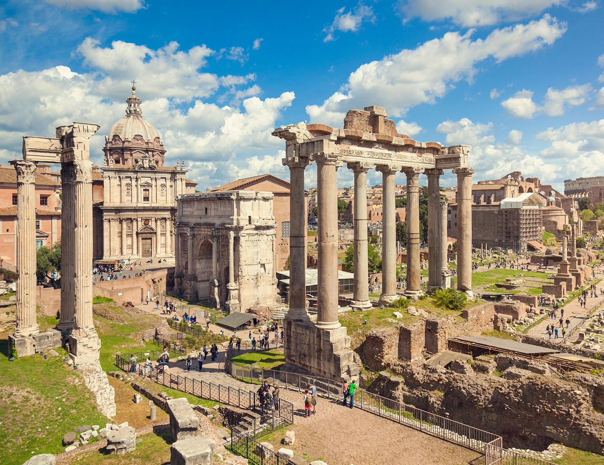
Romulus and Remus
- Describe Rome’s Origin Story
Week 4 Lesson 1
Ms Barrie

Slide 2
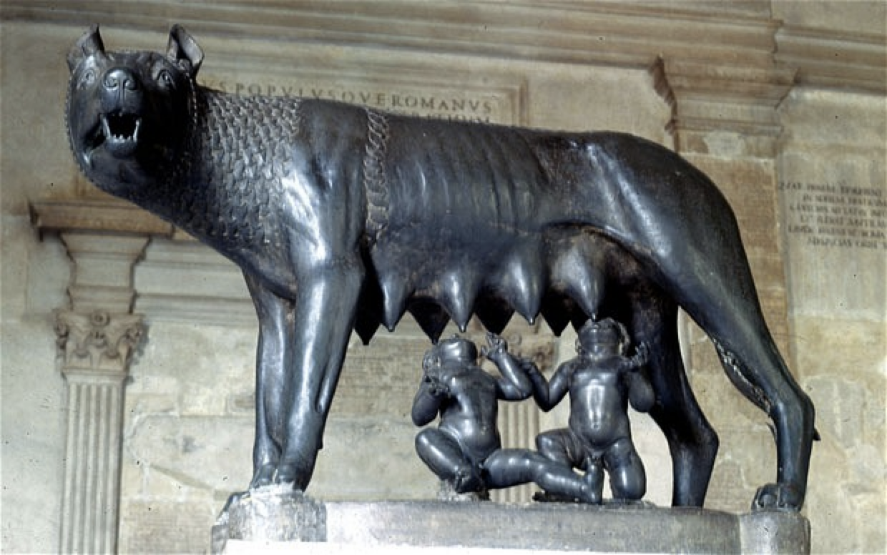
What do you already know about Romulus and Remus?

Slide 3
Romulus and Remus
Romulus is given the credit for founding Ancient Rome – so legend has it. Children in Roman schools were taught the story and it became almost set in stone.
What is the legend of Romulus and Remus?
Romulus and Remus were twin brothers. They were abandoned by their parents as babies and put into a basket that was then placed into the River Tiber.
The basket ran aground and the twins were discovered by a female wolf. The wolf nursed the babies for a short time before they were found by a shepherd. The shepherd then brought up the twins.
When Romulus and Remus became adults, they decided to found a city where the wolf had found them.
The brothers quarrelled over where the site should be and Remus was killed by his brother. This left Romulus the sole founder of the new city and he gave his name to it – Rome.
When was Rome founded
The date given for the founding of Rome is 753 BC.
Notes:
NOTE:
Romulus is given the credit for founding Ancient Rome – so legend has it. Children in Roman schools were taught the story and it became almost set in stone.
What is the legend of Romulus and Remus?
Romulus and Remus were twin brothers. They were abandoned by their parents as babies and put into a basket that was then placed into the River Tiber.
The basket ran aground and the twins were discovered by a female wolf. The wolf nursed the babies for a short time before they were found by a shepherd. The shepherd then brought up the twins.
When Romulus and Remus became adults, they decided to found a city where the wolf had found them.
The brothers quarrelled over where the site should be and Remus was killed by his brother. This left Romulus the sole founder of the new city and he gave his name to it – Rome.
When was Rome founded
The date given for the founding of Rome is 753 BC.
This story, of course, is only a legend. The actual growth of Rome is less exotic and interesting. The city of Rome grew out of a number of settlements that existed around seven hills that were near the River Tiber.

Slide 4
ACTIVITY - Documentary
As you watch the video, take notes in your book as to the foundation story of Rome
Include in your notes:
Key People
Key Events
Key Ideas

Slide 5
Documentary:
https://www.youtube.com/watch?v=mb7074GIIGc&list=PLvoRlZFMwbkqx5GsK9E8Q37fDLOhlmAzy&ab_channel=BanijayHistory

